Slide 1

Machine Learning for IoT Data (I) IS4151/IS5451 – AIoT Solutions and Development AY 2024/25 Semester 2
10
Lecture
Lecturer: A/P TAN Wee Kek
Email: tanwk@comp.nus.edu.sg :: Tel: 6516 6731 :: Office: COM3-02-35
Consultation: Tuesday, 2 pm to 4 pm. Additional consultations by appointment are welcome.

Slide 2

Quick Recap…
In the previous lecture, we learnt:
More about supervised learning and unsupervised learning.
How to perform data preparation with Pandas.
How to perform data visualisation with Matplotlib.
We now have sufficient knowledge to build machine learning models to enable smart AIoT systems.
IoT Development
AI Machine Learning
Single-board Microcontroller
Single-board Computer
IoT Backend Integration
Android Development for IoT
IoT Data Preprocessing
Machine Learning for IoT Data
Computer Vision for IoT
IoT Architecture, Design and Protocols
Pervasive Computing
Technical Concepts
Introduction to Artificial Intelligence of Things

Slide 3

Learning Objectives
At the end of this lecture, you should understand:
How to perform prediction with regression analysis.
How to perform prediction with regression that involves categorical independent variables.
How to perform prediction with classification.
IoT Development
AI Machine Learning
Single-board Microcontroller
Single-board Computer
IoT Backend Integration
Android Development for IoT
IoT Data Preprocessing
Machine Learning for IoT Data
Computer Vision for IoT
IoT Architecture, Design and Protocols
Pervasive Computing
Technical Concepts
Introduction to Artificial Intelligence of Things

Slide 4

Readings
Required readings:
None.
Suggested readings:
None.

Slide 5

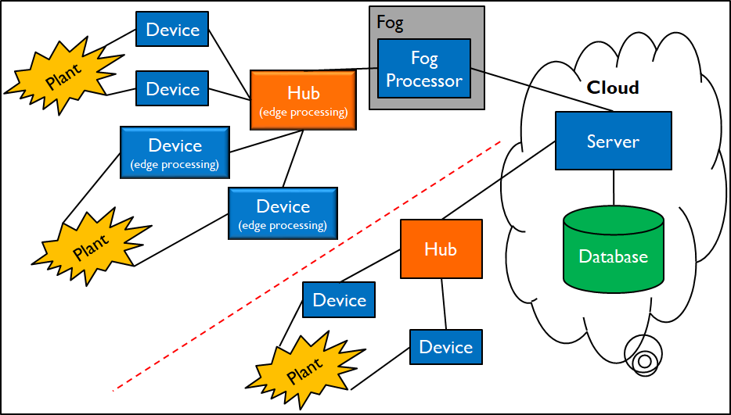
Technical Roadmap for IS4151/IS5451
Single-board Microcontroller
Android Wear
Single-board Computer
Android App
IoT Backend Integration
AI & ML

Slide 6
Recap on Machine Learning
Recall that machine learning employs statistical and mathematical techniques to build a model based on sample data
The objective is to identify patterns among variables in the data, i.e., data mining:
Data mining involves three main patterns:
Prediction
Segmentation
Data Mining
Classification
Regression
Association

Slide 7
Application of Regression to IoT Data
S/N | Application | Scenario | Regression Input/Output
1 | Energy Consumption Forecasting | Smart meters in buildings or homes | Predict future energy usage (kWh) based on past consumption, weather data, and occupancy levels.
2 | Predictive Maintenance | IoT sensors on machinery/equipment in factories. | Estimate Remaining Useful Life (RUL) or time until a part fails.
3 | Environmental Monitoring | Sensors tracking temperature, humidity, air quality, etc. | Predict future environmental conditions (e.g., air pollution levels such as PM2.5 at a given time).
4 | Smart Agriculture | IoT devices monitor soil moisture, temperature, light levels. | Predict crop yield (tons per hectare) or optimal irrigation volume.
5 | Traffic Flow Prediction | Smart city sensors track vehicle counts, speeds, and flow rates. | Predict number of vehicles passing a junction or average speed in the next hour.

Slide 8
Application of Classification to IoT Data
S/N | Application | Scenario | Classification Input/Output
1 | Predictive Maintenance | Fault detection with sensors on industrial machines that monitor vibration, temperature, etc. | Determine if a machine is in a normal or faulty state.
2 | Health Monitoring | Disease detection with wearable devices that collect data like heart rate, blood oxygen, and sleep patterns. | Identify risk of a health condition (e.g., arrhythmia, sleep apnea) – Healthy, At Risk, Needs Immediate Attention.
3 | Smart City | Traffic violation detection with cameras and IoT sensors that track vehicles. | Automatically detect traffic violations (Speeding, Illegal Parking, Red Light Violation) or categorize vehicle types.
4 | Smart Agriculture | Plant disease detection with sensors and cameras that monitor crops. | Detect whether a plant is healthy or affected by a specific disease (Healthy, Bacterial Blight, Leaf Spot, Rust).
5 | Water Quality Monitoring | IoT sensors that monitor turbidity, pH, etc. | Classify water as safe or unsafe for drinking.

Slide 9
Prediction with Regression Analysis

Slide 10
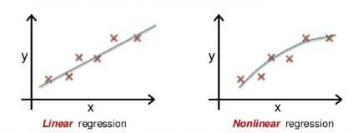
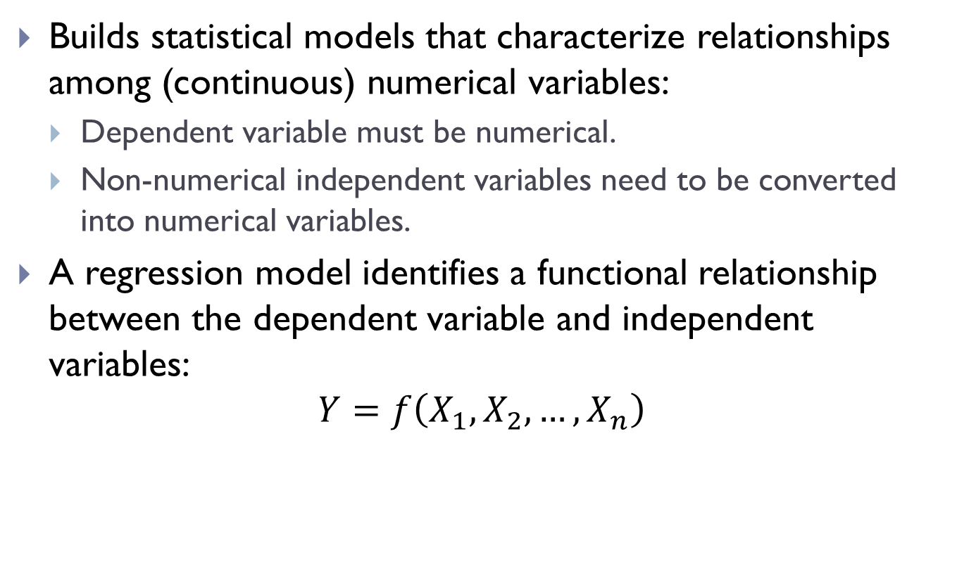
What is Regression Analysis?
Builds statistical models that characterize relationships among (continuous) numerical variables:
Dependent variable must be numerical.
Non-numerical independent variables need to be converted into numerical variables.
A regression model identifies a functional relationship between the dependent variable and independent variables:
$$Y=f\left(X_{1},X_{2},…,X_{n}\right)$$

Slide 11
Linear Regression Model
If we assume that the functional relationship is linear, we have linear regression models:
Most nonlinear relationship may be reduced to a linear one by a suitable transformation.
E.g., an exponential relationship $Y=e^{b+wX}$ can be linearized through a logarithmic transformation $Z=log\left(Y\right)$ into a linear relationship $Z=b+wX$.
A simple linear relationship has one independent variable and is of the form:
$$Y=α+βX+ε$$
$ε$ is a random variable known as error, which indicates the discrepancy between the response $Y$ and the prediction
$$f\left(X\right)=α+βX$$

Slide 12
Linear Regression Model (cont.)
A multiple linear relationship has multiple independent variable and is of the form:
$$Y=α+β_{1}X_{1}+β_{2}X_{2}+…+β_{n}X_{n}+ε$$

Slide 13
Simple Linear Regression
Simple linear regression is analogue to linear equation:
In a linear equation $y=mx+c$, the points $(x_{n},y_{n})$ lies exactly on a physical line.
In a simple linear regression $Y=α+βX+ε$, we try to fit an imaginary line through the observations as best as possible.
$$y=mx+c$$
$$Y=α+βX+ε$$
$$ε_{i}$$
$$β$$
m = gradient
c = y-intercept
$α$ = when $X=0$
Linear Equation
Simple Linear Regression

Slide 14
Simple Linear Regression (cont.)
In simple linear regression, we want to minimize the error of the prediction:
$$ε_{i}=y_{i}−f\left(x_{i}\right)=y_{i}−α−βx_{i}=y_{i}−\hat{y_{i}}$$
The regression coefficients $α$ and $β$ can be computed by the method of least squares which minimizes the sum of the squared errors $SSE=\sum_{i=1}^{s}{{ε_{i}}^{2}}$
This technique is known as the ordinary least squares (OLS) regression.

Slide 15
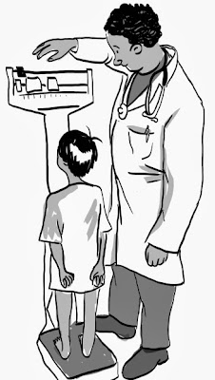
Example of Simple Linear Regression
Predict a child’s weight based on height:
The dataset contains 19 observations.
There are four variables altogether – Name, Weight (pound), Height (cm) and Age.
In Python, we use both Scikit Learn and StatsModels to perform linear regression:
StatsModels provide more summary statistics as compared to Scikit Learn.
We could also manually calculate the required statistics...
Refer to sample source file src01 for the example.

Slide 16
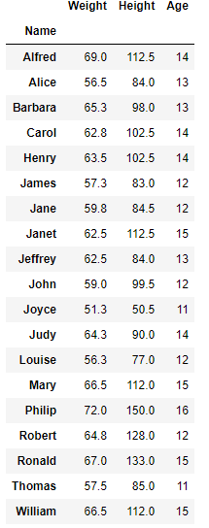
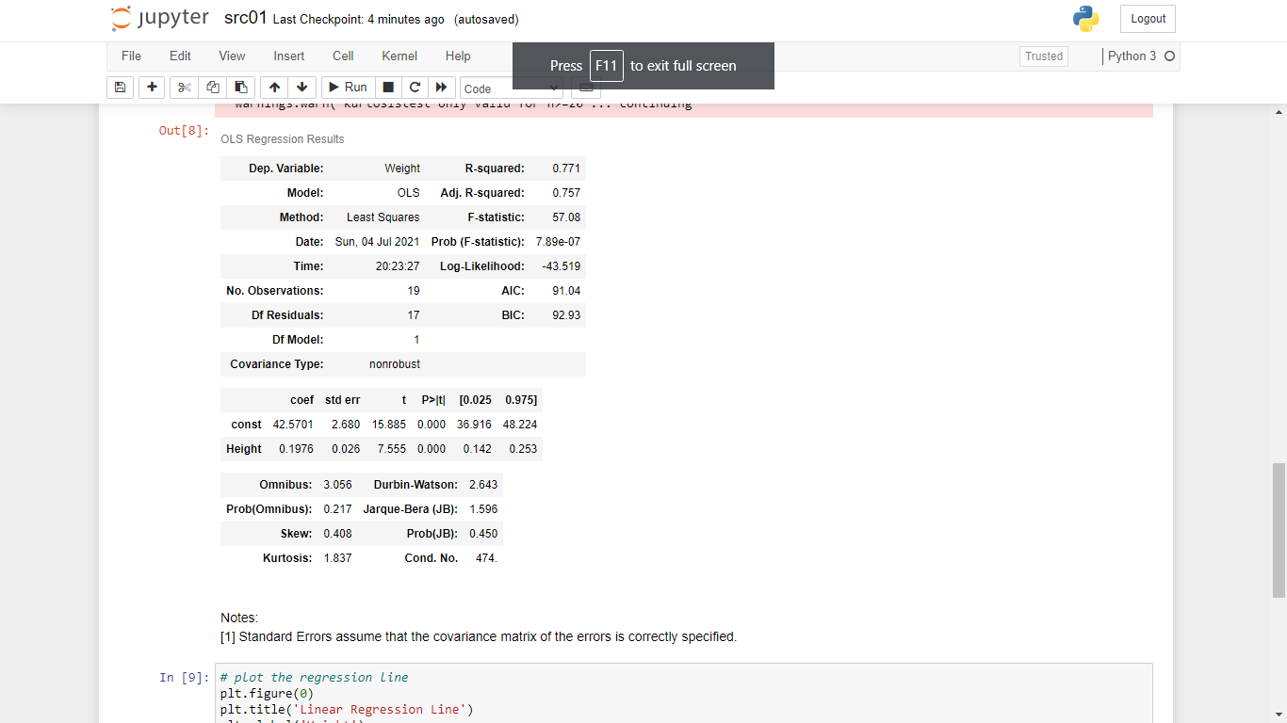
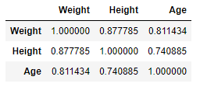
Example of Simple Linear Regression (cont.)
Left to Right – Dataset, correlation matrix and regression results

Slide 17
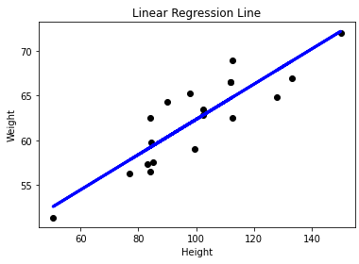
Example of Simple Linear Regression (cont.)
Interpreting the regression model:
The regression equation is $y=42.5701+0.1976x+ε$
$β=0.1976$ implies a one unit increase in height leads to an expected increase of 0.1976 unit in weight.
$α=42.5701$ implies that when $x=0$, $y=42.5701$ (danger of extrapolation).
$N=19$ is the number of observations – Most of the dots, i.e., actual $\left(x_{i},y_{i}\right)$ values, are close to the fitted line.

Slide 18
Example of Simple Linear Regression (cont.)
Is the regression model good?
Analysis of Variance:
F-value = 57.08
The corresponding p-value is < 0.0001, indicating that at least one of the independent variables is useful for predicting the dependent variable.
In this case, since there is only one independent variable, i.e., the value of height is useful for predicting the value of weight.
Regression coefficient:
The corresponding p-value for the intercept and regression coefficient is < 0.0001.
We can reject the null hypotheses that the intercept and regression coefficient are zero.

Slide 19
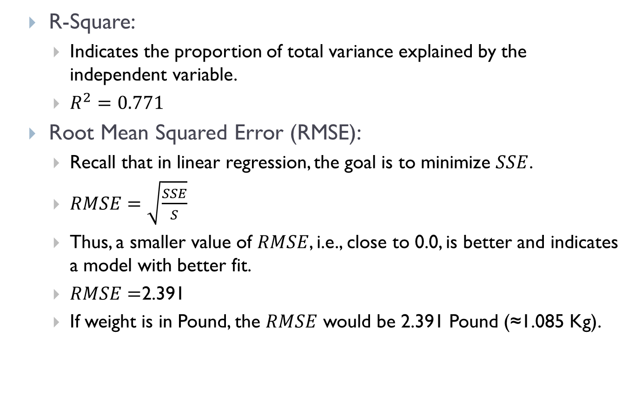
Example of Simple Linear Regression (cont.)
R-Square:
Indicates the proportion of total variance explained by the independent variable.
$R^{2}=0.771$
Root Mean Squared Error (RMSE):
Recall that in linear regression, the goal is to minimize $SSE$.
$RMSE=\sqrt{\frac{SSE}{S}}$
Thus, a smaller value of $RMSE$, i.e., close to 0.0, is better and indicates a model with better fit.
$RMSE=$2.391
If weight is in Pound, the $RMSE$ would be 2.391 Pound (≈1.085 Kg).

Slide 20
Validating the Assumptions of Linear Regression
Linear regression has five key assumptions.
Linear relationship:
Relationship between the independent and dependent variables is linear – Check regression line for linearity.
Homoscedasticity:
Residuals are equal across the regression line.
Scatter plots between residuals and predicted values are used to confirm this assumption.
Any pattern would result in a violation of this assumption and point toward a poor fitting model.
Refer to sample source file src02 for the example.

Slide 21
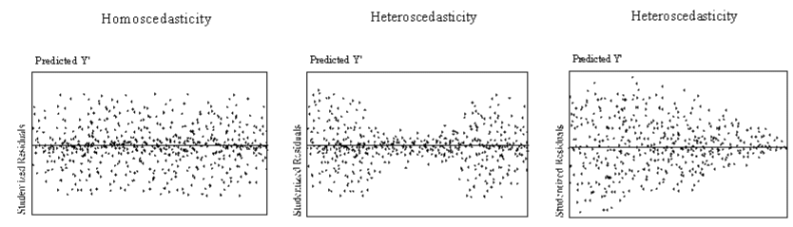
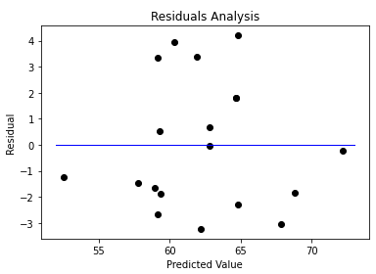
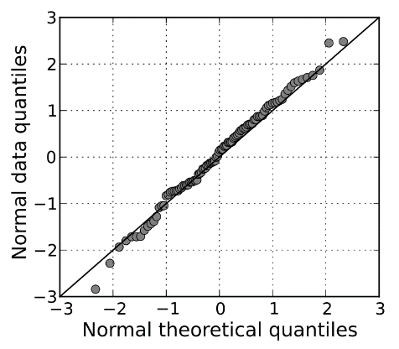
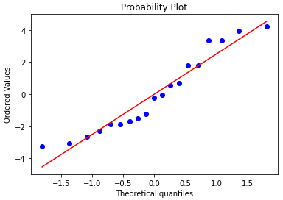
Validating the Assumptions of Linear Regression (cont.)
We can also check the normality of the residuals using a Q-Q plot – Data points must fall (approximately) on a straight line for normal distribution.
Refer to sample source file src03 for the example.

Slide 22
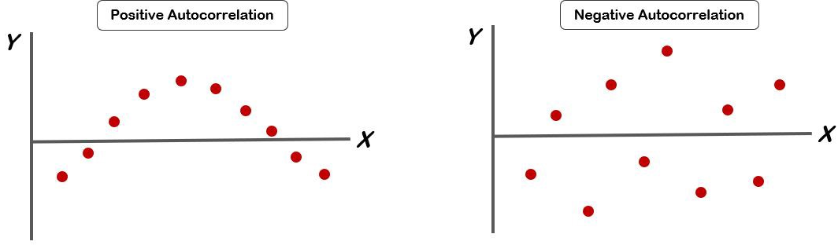
Validating the Assumptions of Linear Regression (cont.)
Auto-correlation
Residuals must be independent from each other.
Scatter plots between residuals and predicted values – Residuals are randomly distributed with no pattern.
We can also use the Durbin-Watson test to test the null hypothesis that the residuals are not linearly auto-correlated:
The test statistic lies in the range $0≤d≤4$ and $d≈2$ indicates no autocorrelation.
$d<2$ and $d>2$indicates positive and negative autocorrelation
In our example, $d=2.643$.

Slide 23
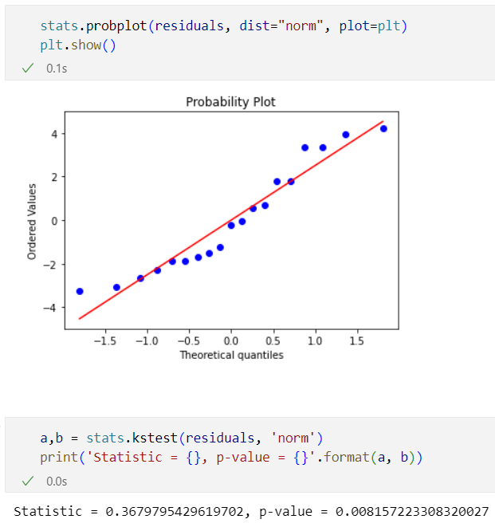
Validating the Assumptions of Linear Regression (cont.)
Multivariate normality:
Residuals must be normally distributed.
We can perform visual/graphical test to check for normality of the data using Q-Q plot and also histogram.
We can also validates statistically using the Kolmogorov–Smirnov test.
Refer to sample source file src04 (similar to src03) for the example.

Slide 24
Validating the Assumptions of Linear Regression (cont.)
Multicollinearity:
Independent variables are not correlated with each other.
For simple linear regression, this is not an issue.
Child’s weight example:
We may conclude that the residuals are independent but not normally distributed.
The linear regression model generally fits the data well.

Slide 25
Multiple Linear Regression
Limitations of simple linear regression:
In many real-world scenarios, there are likely more than one independent variables that are correlated with the dependent variable.
Multiple linear regression allows us to handle such scenarios.
Recall that multiple linear regression is of the form:
$$Y=α+β_{1}X_{1}+β_{2}X_{2}+…+β_{n}X_{n}+ε$$
The regression coefficient $β_{j}$ expresses the marginal effect of the variable $X_{j}$ on the dependent variable $Y$, conditioned on the current value of the remaining independent variables.
Scale of the values influences the value of the corresponding regression coefficient and thus it might be useful to standardize the independent variables.

Slide 26
Example of Multiple Linear Regression
Predict colleges and universities graduation rate:
Predict the percentage of students accepted into a college program who would eventually graduate.
The dataset contains 49 observations.
There are five possible independent variables altogether:
Type – Type of college, i.e., University or Liberal Arts.
MedianSAT
AcceptanceRate
ExpendituresPerStudent
Top10PercentHS – Proportion of accepted students who are among the top 10% of their high school cohort.
We will exclude Type as it is a nominal categorical variable.
Refer to sample source file src05 for the example.

Slide 27
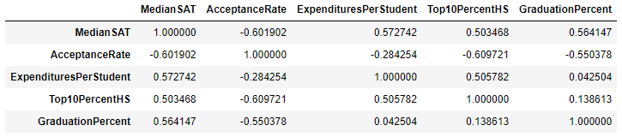
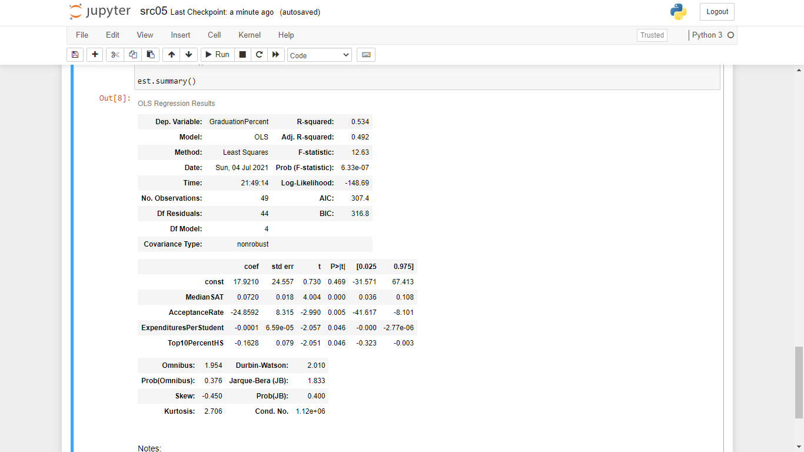
Example of Multiple Linear Regression (cont.)
Top to Bottom – Correlation matrix and regression results

Slide 28
Example of Multiple Linear Regression (cont.)
Interpreting the regression model:
The regression equation is:
$$GraduationPercent=17.921+0.0720MedianSAT−24.8592AcceptanceRate−0.0001ExpendituresPerStudent−0.1628Top10PercentHS$$
Interpreting the regression coefficients:
Higher median SAT scores and lower acceptance rates suggest higher graduation rates.
1 unit increase in median SAT scores increase graduation rates by 0.0720 unit, all other things being equal.
1 unit increase in acceptance rates decrease graduation rates by 24.8592 unit, all other things being equal.

Slide 29
Example of Multiple Linear Regression (cont.)
Overall:
F-value = 12.63 with a corresponding p-value < 0.0001
The corresponding p-value for the intercept is >= 0.05 but those for the regression coefficient is < 0.05
Do the regression coefficients and their signs make sense?
$R^{2}=0.534$
$R^{2}$ and Adjusted $R^{2}$ are quite similar:
In a multiple linear regression model, this means that the inclusion of multiple independent variables is useful.
$RMSE=5.03$

Slide 30
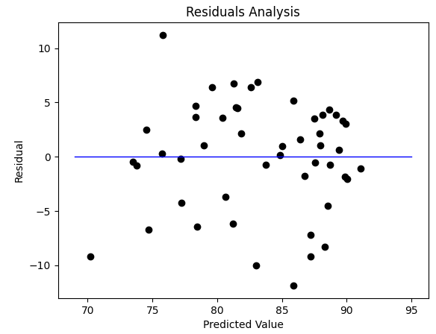
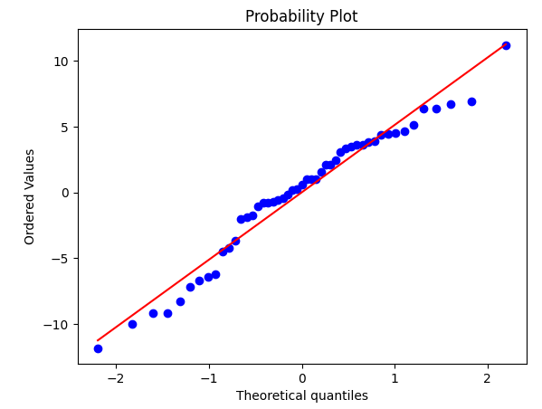
Evaluating the Assumptions of Linear Regression
Residuals analysis:
The scatter plot of residuals against predicted values and the Q-Q plot of the residuals shows that the residuals are independent but not normally distributed.
See the sample script src06.

Slide 31
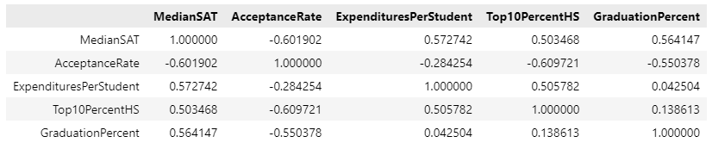
Evaluating the Assumptions of Linear Regression (cont.)
Multicollinearity:
Occurs when significant linear correlation exists between two or more predictive variables.
Potential problems:
Regression coefficients are inaccurate.
Compromises overall significance of the model.
Possible that the coefficient of determination is close to 1 while the regression coefficients are not significantly different from 0.
Pairwise linear correlation coefficients may be calculated.

Slide 32

Evaluating the Assumptions of Linear Regression (cont.)
We can observe mild correlation among the four independent variables.
Consequently, you would see that even though $R^{2}$ is moderately high, two of the independent variables, i.e., ExpenditurePerStudent and Top10PercentHS, are just below the 0.05 (or 95%) significance threshold.

Slide 33
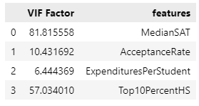
Evaluating the Assumptions of Linear Regression (cont.)
To identify multiple linear relationships or multicollinearity among predictive variables:
Calculate the variance inflation factor (VIF) for each predictor as:
where is the coefficient of determination for the
model that explains , treated as a response, through
the remaining independent variables.
indicates multicollinearity.
VIF can be calculated in StatsModels – See the sample script src07.

Slide 34
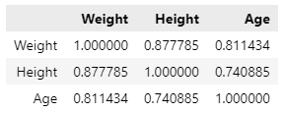
Revisiting the Child’s Weight Prediction Case Study
From the perspective of multiple linear regression, would Age be a useful predictor of Weight in addition to Height?
Recall the correlation matrix:
Refer to sample source file src08 for the example.

Slide 35
Encoding Categorical Independent Variables for Regression

Slide 36
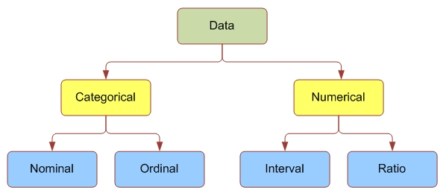
Recap on Regression Analysis…
Recall that regression analysis builds statistical models that characterize relationships among (continuous) numerical variables:
Dependent variable must be numerical.
Non-numerical independent variables can be converted into numerical variables.
Taxonomy of data:

Slide 37
Categorical Data
Categorical Data:
Represent the labels of multiple classes used to divide a variable into specific groups.
E.g., race, sex, age group and educational level.
Nominal data:
Categorical variables without natural ordering.
E.g., Marital status can be categorized into (1) single, (2) married and (3) divorced.
Ordinal data:
Categorical variables that lend themselves to natural ordering.
More specifically, the codes assigned to objects represent the rank order among them.

Slide 38
Categorical Data (cont.)
But it makes no sense to calculate the differences or ratios between values.
E.g., credit score can be categorized as (1) low, (2) medium and (3) high.
However, the additional rank-order information is useful in certain machine learning algorithms for building a better model.

Slide 39
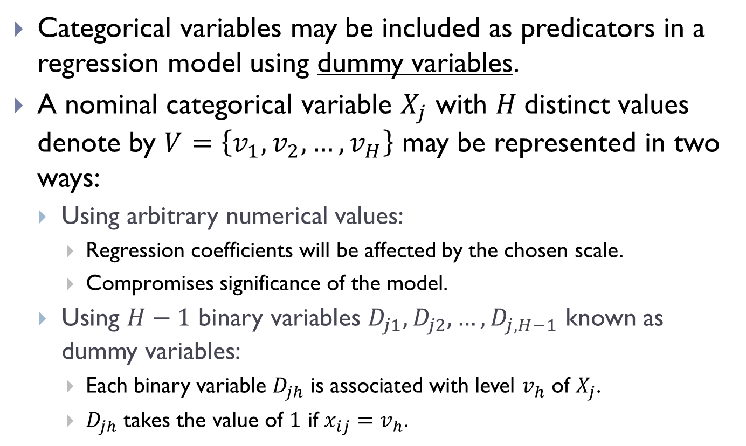
Treatment of Categorical Independent Variables
Categorical variables may be included as predicators in a regression model using dummy variables.
A nominal categorical variable $X_{j}$ with $H$distinct values denote by $V=\left\{v_{1},v_{2},…,v_{H}\right\}$ may be represented in two ways:
Using arbitrary numerical values:
Regression coefficients will be affected by the chosen scale.
Compromises significance of the model.
Using $H−1$ binary variables $D_{j1},D_{j2},…,D_{j,H−1}$ known as dummy variables:
Each binary variable $D_{jh}$ is associated with level $v_{h}$ of $X_{j}$.
$D_{jh}$ takes the value of $1$ if $x_{ij}=v_{h}$.

Slide 40
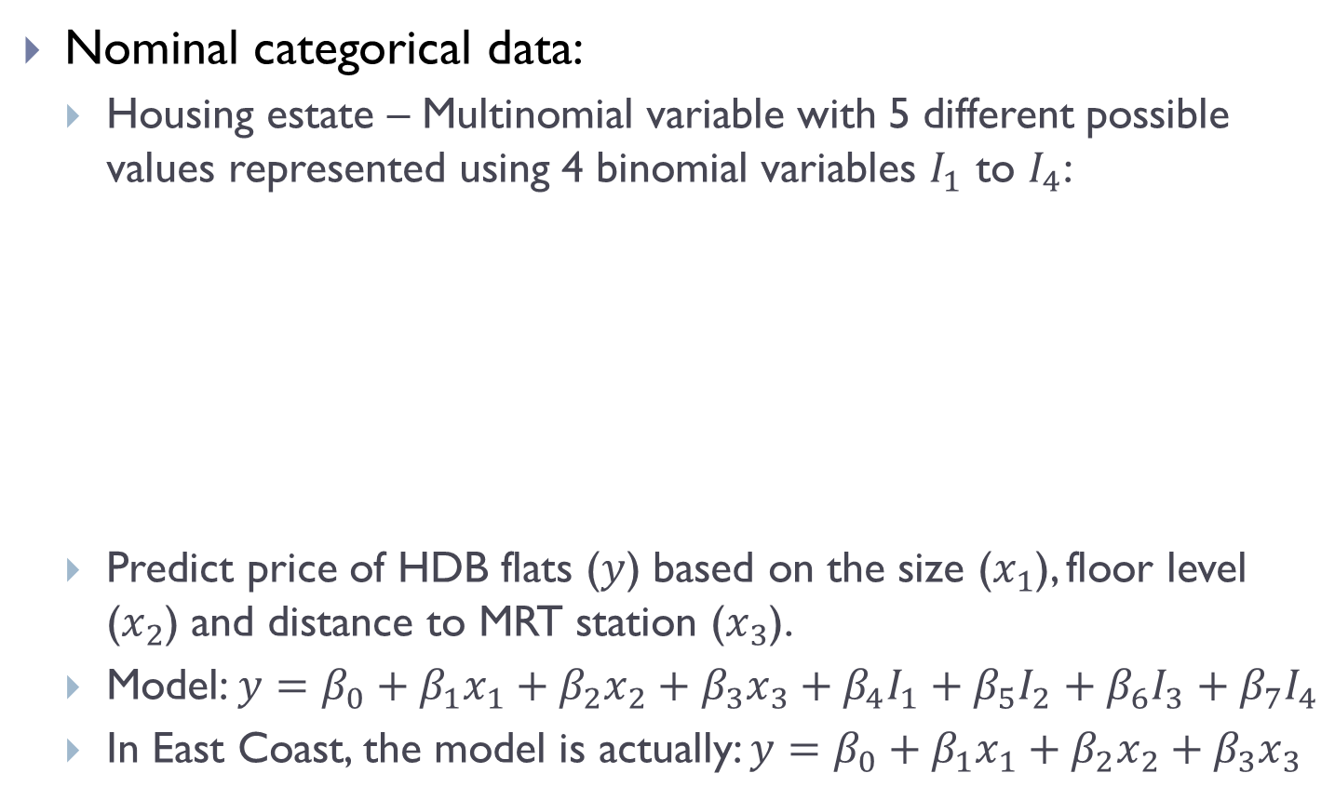
Data Encoding Examples with Multiple Linear Regression
Nominal categorical data:
Housing estate – Multinomial variable with 5 different possible values represented using 4 binomial variables $I_{1}$ to $I_{4}$:
Predict price of HDB flats ($y$) based on the size ($x_{1}$), floor level ($x_{2}$) and distance to MRT station ($x_{3}$).
Model: $y=β_{0}+β_{1}x_{1}+β_{2}x_{2}+β_{3}x_{3}+β_{4}I_{1}+β_{5}I_{2}+β_{6}I_{3}+β_{7}I_{4}$
In East Coast, the model is actually: $y=β_{0}+β_{1}x_{1}+β_{2}x_{2}+β_{3}x_{3}$
Housing Estate | I₁ | l₂ | l₃ | l₄
Ang Mo Kio | 1 | 0 | 0 | 0
Bishan | 0 | 1 | 0 | 0
Clementi | 0 | 0 | 1 | 0
Dover | 0 | 0 | 0 | 1
East Coast | 0 | 0 | 0 | 0

Slide 41
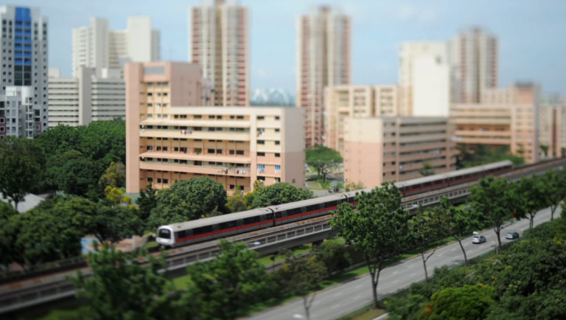
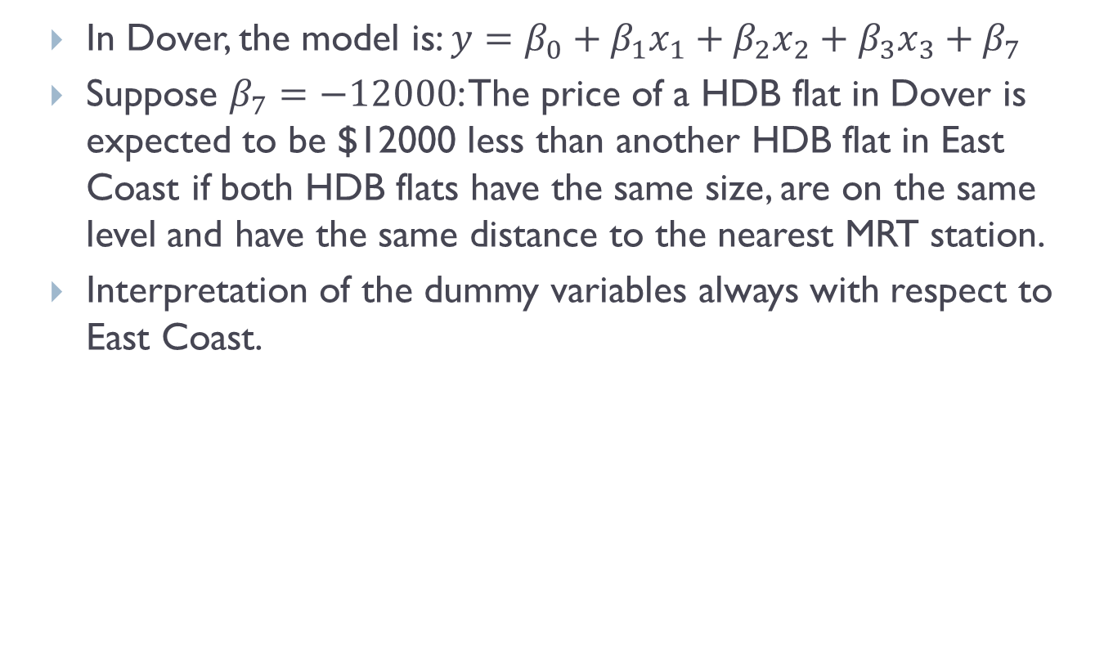
Data Encoding Examples with Multiple Linear Regression (cont.)
In Dover, the model is: $y=β_{0}+β_{1}x_{1}+β_{2}x_{2}+β_{3}x_{3}+β_{7}$
Suppose $β_{7}=−12000$: The price of a HDB flat in Dover is expected to be $12000 less than another HDB flat in East Coast if both HDB flats have the same size, are on the same level and have the same distance to the nearest MRT station.
Interpretation of the dummy variables always with respect to East Coast.

Slide 42
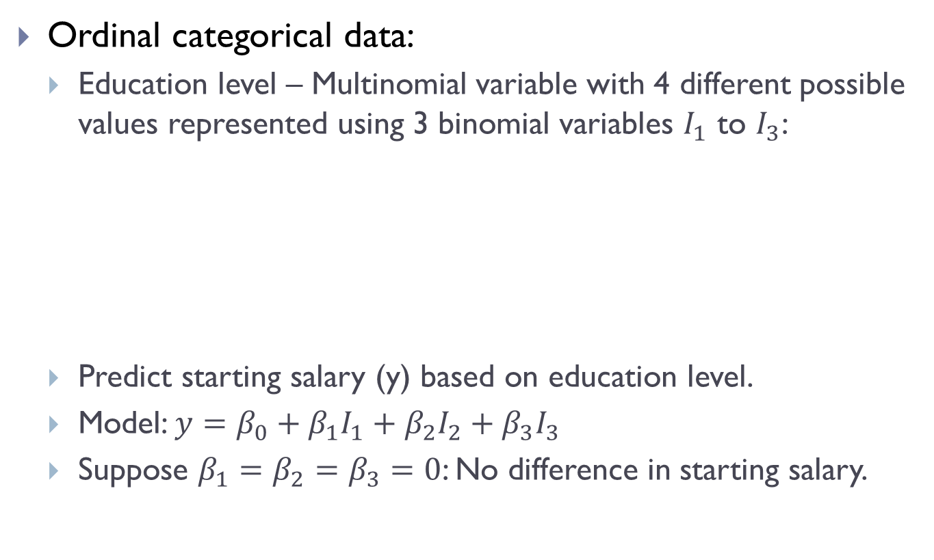
Data Encoding Examples with Multiple Linear Regression (cont.)
Ordinal categorical data:
Education level – Multinomial variable with 4 different possible values represented using 3 binomial variables $I_{1}$ to $I_{3}$:
Predict starting salary (y) based on education level.
Model: $y=β_{0}+β_{1}I_{1}+β_{2}I_{2}+β_{3}I_{3}$
Suppose $β_{1}=β_{2}=β_{3}=0$: No difference in starting salary.
Education Level | I₁ | l₂ | l₃
Elementary School | 0 | 0 | 0
High School | 1 | 0 | 0
College | 1 | 1 | 0
Graduate School | 1 | 1 | 1

Slide 43
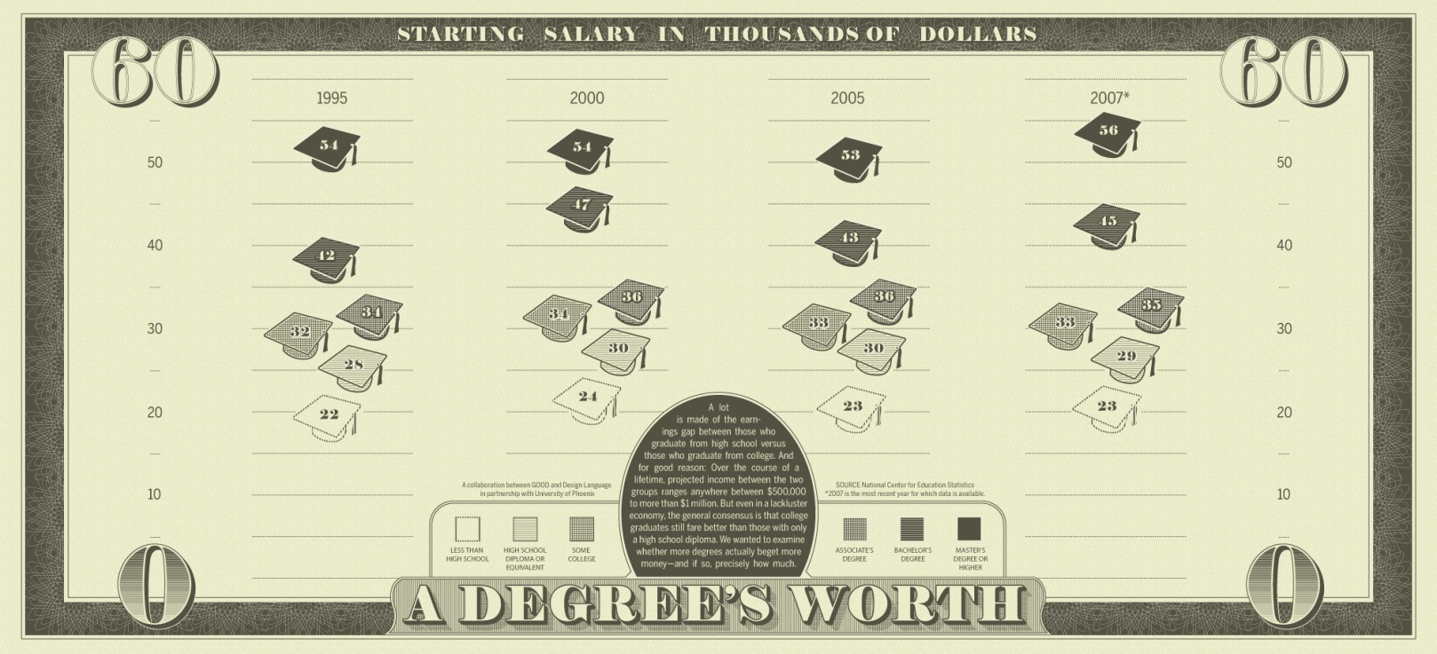

Data Encoding Examples with Multiple Linear Regression (cont.)
Suppose $β_{1}=0,β_{2}>0,β_{3}=0$:
Model: $y=β_{0}+β_{2}I_{2}$
When education level is high school or lower, $y=β_{0}$
When education level is college or higher, $y=β_{0}+β_{2}$

Slide 44
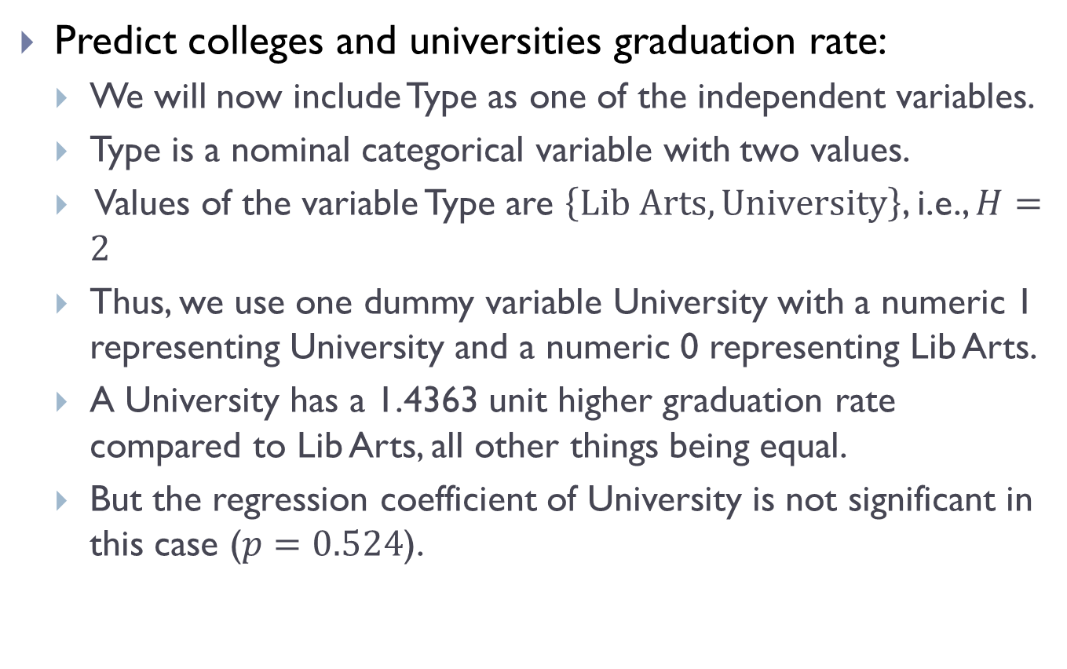
Example of Categorical Independent Variables
Predict colleges and universities graduation rate:
We will now include Type as one of the independent variables.
Type is a nominal categorical variable with two values.
Values of the variable Type are $\left\{\text{Lib} \text{Arts}, \text{University}\right\}$, i.e., $H=2$
Thus, we use one dummy variable University with a numeric 1 representing University and a numeric 0 representing Lib Arts.
A University has a 1.4363 unit higher graduation rate compared to Lib Arts, all other things being equal.
But the regression coefficient of University is not significant in this case ($p=0.524$).

Slide 45
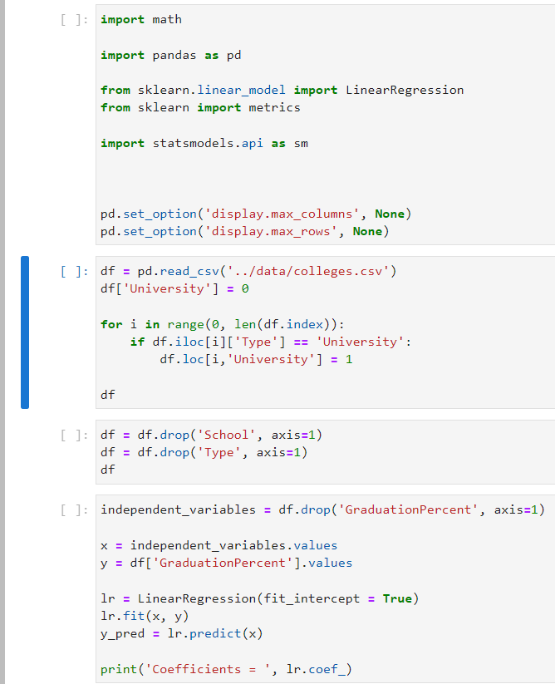

Example of Categorical Independent Variables (cont.)
Dummy coding of “University”
src09

Slide 46
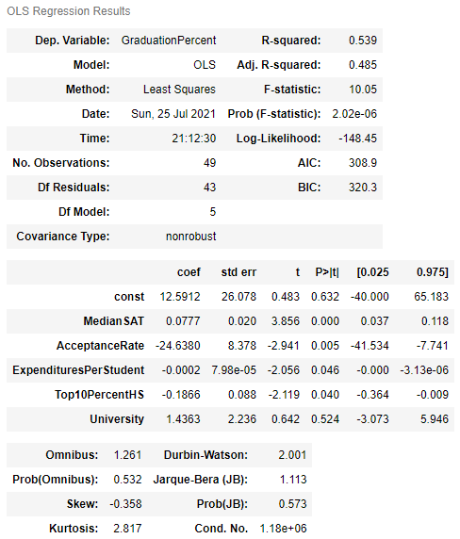
Example of Categorical Independent Variables (cont.)

Slide 47
Prediction with Classification

Slide 48
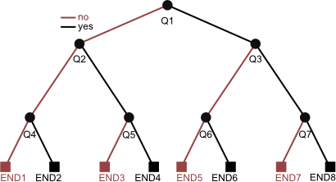
Decision Trees
The best known and most widely used learning methods in data mining applications.
Reasons for its popularity include:
Conceptual simplicity.
Ease of usage.
Computational speed.
Robustness with respect to missing data and outliers.
Interpretability of the generated rules.

Slide 49
Decision Trees (cont.)
The development of a decision tree involves recursive, heuristic, top-down induction:
Initialization phase – All observations are placed in the root of the tree. The root is placed in the active node list .
If the list is empty, stop the procedure. Otherwise, node is selected, removed from the list and used as the node for analysis.
The optimal rule to split the observations in is then determined, based on an appropriate preset criterion:
If does not need to be split, node becomes a leaf, target class is assigned according to majority class of observations.
Otherwise, split node , its children are added to the list.
Go to Step 2.

Slide 50
Components of Decision Trees
Components of the top-down induction of decision trees:
Splitting rules – Optimal way to split a node (i.e., assigning observations to child nodes) and for creating child nodes.
Stopping criteria – If the node should be split or not. If not, this node becomes a leaf of the tree.
Pruning criteria – Avoid excessive growth of the tree during tree generation phase (pre-pruning) and reduce the number of nodes after the tree has been generated (post-pruning).
Exam ≥ 80?
Assignment ≥ 80%?
C
B
Assignment ≥ 50%?
B
A
No
Yes
A simple decision tree:
Left branch for “No”
Right branch for “Yes”
No
Yes
No
Yes

Slide 51
Example of a Decision Tree
Given the dataset:
The task is to predict Loan-Risk.
We will be using the univariate binary splitting approach.
Observation # | Income | Credit Rating | Loan Risk
0 | 23 | High | High
1 | 17 | Low | High
2 | 43 | Low | High
3 | 68 | High | Low
4 | 32 | Moderate | Low
5 | 20 | High | High

Slide 52
Example of a Decision Tree (cont.)
Given the data set , we start building the tree by creating a root node.
If this node is sufficiently “pure”, then we stop.
If we do stop building the tree at this step, we use the majority class to classify/predict.
In this example, we classify all patterns as having Loan-Risk = “High”.
Correctly classify 4 out of 6 input samples to achieve classification accuracy of:
This node is split according to impurity measures:
Gini Index (used by CART)
Entropy (used by ID3, C4.5, C5)
Loan-Risk = High
Acc = 66.67%

Slide 53
Using Gini Index
CART (Classification and Regression Trees) uses the Gini index to measure the impurity of a dataset:
Gini index for the observations in node is:
where
is the node that contains examples from classes
is a relative frequency of class in node
In our dataset, there are 2 classes High and Low, .

Slide 54

Using Gini Index (cont.)
Should Income be used as the variable to split the root node?
Income is a variable with continuous values.
Sort the data according to Income values:
Observation # | Income | Credit Rating | Loan Risk
1 | 17 | Low | High
5 | 20 | High | High
0 | 23 | High | High
4 | 32 | Moderate | Low
2 | 43 | Low | High
3 | 68 | High | Low
Split 1
Split 2
Split 3

Slide 55
Using Gini Index (cont.)
We consider 3 possible splits when there are changes in the value of Loan-Risk.
Case 1 – Split condition Income ≤ 23 versus Income > 23
Impurity after split:
Loan Risk = High
Acc = 66.67%
Gini(q) = 4/9
Income ≤ 23
Income > 23
$$I_{G}\left(q_{1}\right)$$
$$I_{G}\left(q_{2}\right)$$
3 High Loan-Risks
0 Low Loan Risk
Gini(q₁) = 0
1 High-Loan Risk
2 Low Loan Risk
Gini(q₂) = 4/9

Slide 56
Using Gini Index (cont.)
Case 2 – Split condition Income ≤ 32 versus Income > 32:
Case 3 – Split condition Income ≤ 43 versus Income > 43:
Case 1 is the best.
Instead of splitting between
Income ≤ 23 versus Income > 23,
the midpoint is selected as actual
splitting point: (23 + 32)/2.
Loan Risk = High
Acc = 66.67%
Gini (q) = 4/9
Income ≤ 27.5
Income > 27.5
3 High Loan-Risks
0 Low Loan Risk
Gini(q₁) = 0
1 High-Loan Risk
2 Low Loan Risk
Gini(q₂) = 4/9

Slide 57
Using Gini Index (cont.)
Apply the tree generating method recursively to nodes that are still not “pure”.
Develop a subtree by examining the variable Credit-Rating.
Credit-Rating is a discrete variable with ordinal values, i.e., they can be ordered in a meaningful sequence.
Loan Risk = High
Acc = 66.67%
Gini(q) = 4/9
Income ≤ 27.5
Income > 27.5
Loan Risk = High
Loan Risk = ?

Slide 58
Using Gini Index (cont.)
Possible values are .
Check for best split:
Case 1 – Low versus (Moderate or High)
Case 2 – (Low or Moderate) versus High
Compute the Gini index for splitting the node:
Loan Risk = ?

Slide 59
Using Gini Index (cont.)
Case 1 – Split Credit-Rating = Low versus Credit-Rating = Moderate or High:
Loan Risk = ?
Credit-Rating=Low
Credit-Rating=Moderate or High
0 Low Loan-Risk
1 High Loan Risk
Gini(q₁) = 0
2 Low Loan-Risk
0 High Loan Risk
Gini(q₂) = 0

Slide 60
Using Gini Index (cont.)
Case 2 – Split Credit-Rating = Low or Moderate versus Credit-Rating = High:
Case 2 split is not as good as Case 1 split.
Loan Risk = ?
Credit-Rating=Low or moderate
Credit-Rating=High
1 Low Loan-Risk
1 High Loan Risk
Gini(q₁) = 1/2
0 Low Loan-Risk
1 High Loan Risk
Gini(q₂) = 0

Slide 61
Using Gini Index (cont.)
Complete tree:
Root
Leaf
Intermediate
Income ≤ 27.5
Income > 27.5
Loan Risk = High
Loan Risk = ?
Credit-Rating=Low
Credit-Rating=Moderate or High
Loan Risk = High
Loan Risk = Low

Slide 62
Using Gini Index (cont.)
The tree achieves 100% accuracy on the training data set.
It may over fit the training data instances.
Trees may be simplified by pruning:
Pre-pruning – Tree growing could be terminated when the number of instances in the node is less than a pre-specified number.
Post-pruning – Removing nodes or branches to improve the accuracy on the test samples.
Observe that we have built a binary tree where every non-leaf nodes have 2 branches.

Slide 63
Decision Tree in Scikit Lean
We can perform decision tree classification using Scikit Learn’s tree.DecisionTreeClassifier.
However, this class cannot process categorical independent variables and thus we need to recode CreditRating:
Use one hot encoding or one-of-K scheme.
CreditRating has three levels – Low, Moderate and High.
Thus, we will create three binary variables – CreditRatingLow, CreditRatingModerate and CreditRatingHigh.
For each observation, only exactly one of these three variables will be set to 1.
Refer to sample source file src10 for the example.

Slide 64
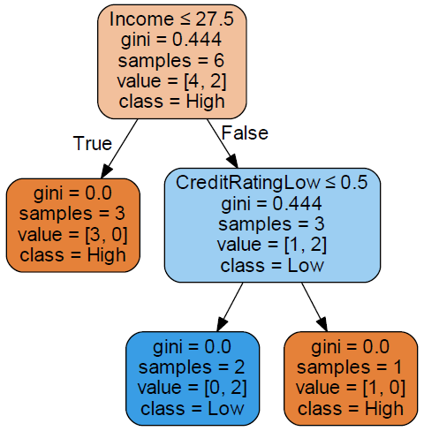
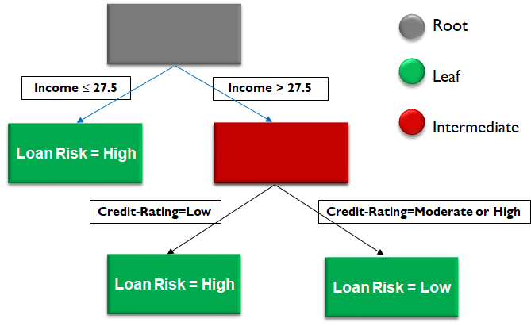
Decision Tree in Scikit Lean (cont.)

Slide 65
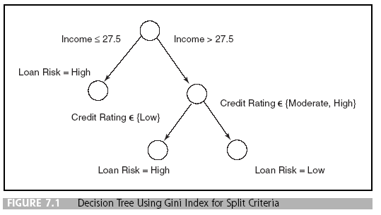
Classification Rule Generation
Trace each path from the root node to a leaf node to generate a rule:
If Income ≤ 27.5, then Loan-Risk = High
Else if Income > 27.5 and Credit-Rating=Low, then Loan-Risk = High
Else if Income > 27.5 and Credit-Rating= Moderate or High, then Loan-Risk = Low

Slide 66

Summary
Linear regression can be used to perform regression analysis using one or more independent variables.
Categorical independent variables can be used in linear regression through appropriate dummy variable encoding.
Decision tree can be used to perform classification analysis.

Slide 67

Q&A

Slide 68

Next Lecture…
Learn about:
How to perform prediction with probabilistic classification.
How to perform prediction with advanced classifiers.
How to perform segmentation with clustering.
IoT Development
AI Machine Learning
Single-board Microcontroller
Single-board Computer
IoT Backend Integration
Android Development for IoT
IoT Data Preprocessing
Machine Learning for IoT Data
Computer Vision for IoT
IoT Architecture, Design and Protocols
Pervasive Computing
Technical Concepts
Introduction to Artificial Intelligence of Things

